Slide 1


Slide 2
Machine learning based hids

Slide 3
Group members
Muhammad Ishfaq 17-arid-1520
Muhammad Waqas 17-arid-1550
Muhammad Ali Arif 17-arid-1499

Slide 4
PROBLEM STATEMENT
THE open source oosec system is avalaible BUT it sends alot of alert calls to the user.Thus the user somtimes ignores these alerts and simply becomes a victim.

Slide 5
PROBLEM SOLUTION
our software will help administrator to find out about who and when someone tried to breach security and what data the intruder tried to access. number of alarms are very higher and thats why the user ignores it and result in loss of data. our system will try to reduce this alarm system and will try to read the encrypted data. our system would also tell the administrator as if any backdoor has been installed or someone tried to login. our system will allow the full protection of IDS from any itruders attacks there data can not be change. To change IDS data a special adminiistrator permission will be needed.

Slide 6
ADVANTAGES/BENEFITS
our system will increase the system securit and will prevent administrator from any loss of data.
Log Analysis will help to identify issues in unstructured data such as log files and configuration files. our system will allow administrator to monitor user log ,file logs and event logs.
. Log analysis data can be used to troubleshoot performance issues with specific applications and identify potentially threatening anomalies

Slide 7
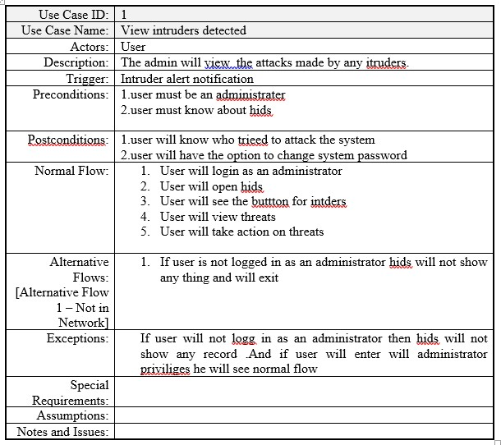
Use case 1

Slide 8
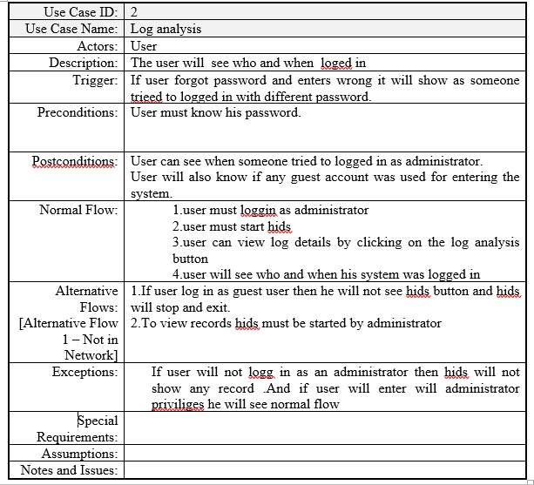
Use case 2

Slide 9
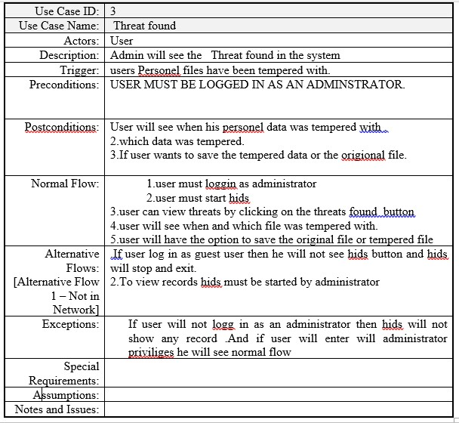
Use case 3

Slide 10
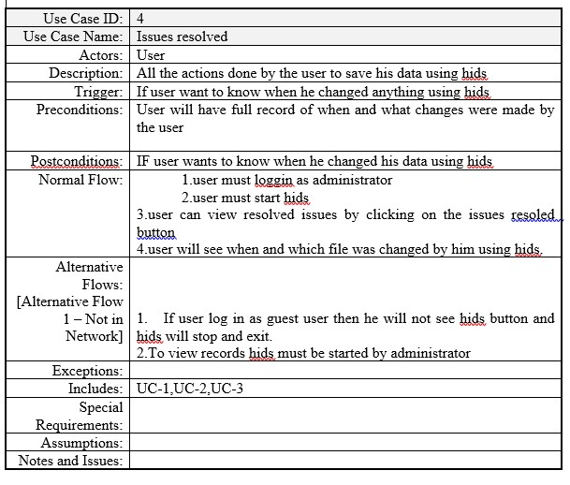
Use case 4

Slide 11
Functional requirements
User Module
Login Module
Logout Module
Signup Module
View log analysis Module

Slide 12
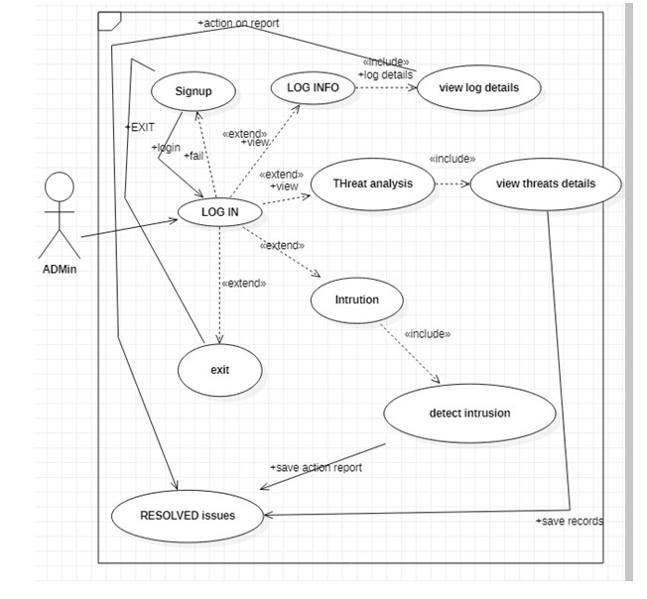
Use case diagram

Slide 13
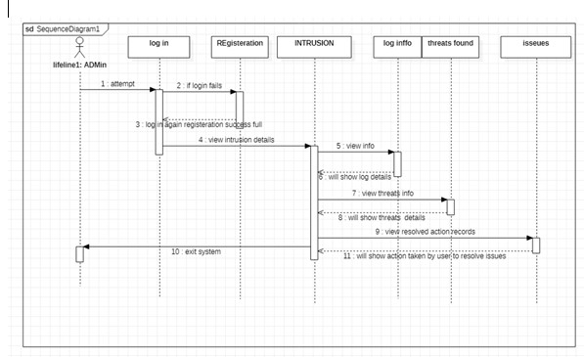
Sequence diagram

Slide 14
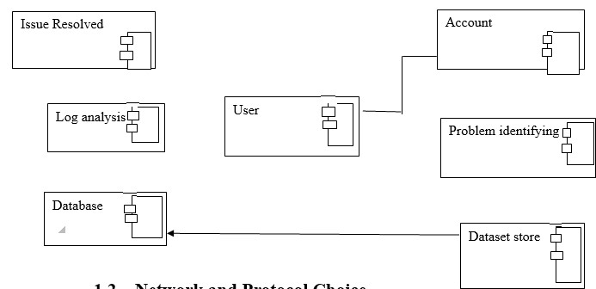
Component diagram

Slide 15
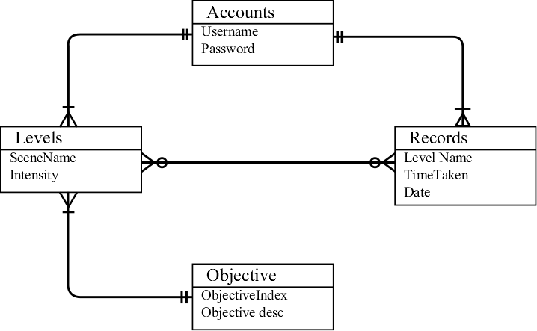
ERD Diagram

Slide 16
Task distribution
# | Task | Responsible
1 | GUI | Muhammad Ishfaq
2 | DOCUMENTATION | Muhammad Ali Arif
3 | Testing | Muhammad Ishfaq
4 | Record Handling | Muhammad Waqas
5 | Installation | Muhammad Ali Arif
6 | Code | Muhammad Waqas

Slide 17
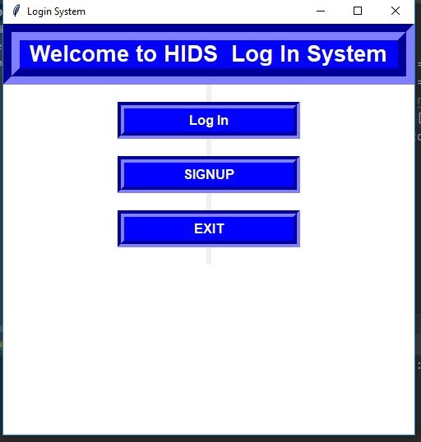
Screen shot

Slide 18
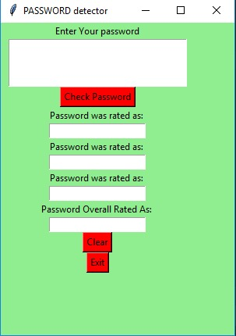
Screen shot

Slide 19
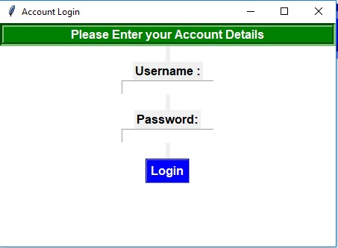
Screen shot

Slide 20
Tool and technologies
Pycharm
Python language
SQL
Java
Open source dataset HDFS
Microsoft Word

Slide 21
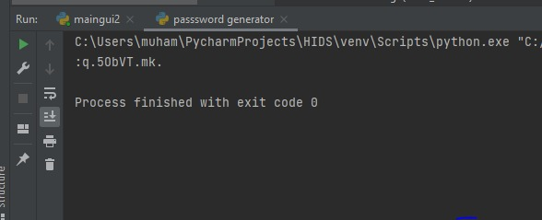
Screen shot

Slide 22
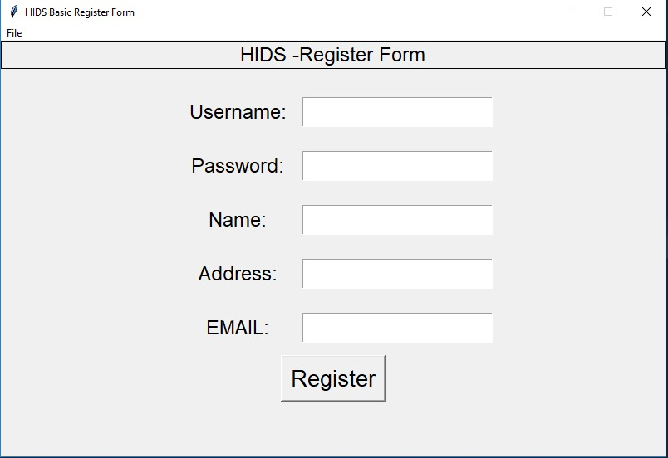
Screen shot

Slide 23


Slide 24


